Slide 1
Project Name: Order-Kraft
Squad - 3
Team Members:
Tejaswini
Lokesh
Sai Vivek
Rahamthulla
Yogeshwaran

Slide 2
Project Overview
OrderKraft is an advanced supply chain and order management platform built to streamline manufacturing processes. By digitizing and automating every step — from order intake to final delivery — it helps businesses achieve higher efficiency, accuracy, and control over their operations.
Purpose and Vision
Automation for Efficiency: OrderKraft automates key workflows, minimizing manual errors and boosting overall productivity.
Seamless Order Management: The platform enables effortless order creation and provides real-time tracking to ensure timely execution and delivery.
Smart Inventory Control: With real-time inventory monitoring and alerts, businesses can prevent stockouts and overstock situations, maintaining optimal inventory levels.
Role-Based Dashboards: Customizable dashboards designed for different roles improve collaboration, coordination, and data-driven decision-making across teams.

Slide 3
User Roles in OrderKraft
Admin: Controls user roles, system setup, and accesses all reports.
Supplier: Provides materials, updates delivery status, and is evaluated on performance.
Procurement Officer: Creates purchase orders, tracks order status, manages suppliers and payments.
Inventory Manager: Manages stock levels, receives alerts, and generates inventory reports.
Production Manager: Plans and tracks production tasks, ensures deadlines are met.

Slide 4
Key Features
Order Management Create, update, and track orders seamlessly to keep operations organized and efficient.
Inventory Tracking Monitor stock levels in real time and receive alerts to prevent shortages or overstock situations.
Supplier Management Add and manage suppliers, track their performance, and handle contracts effectively.
Production Scheduling Plan and oversee production tasks to ensure timelines are met.
Shipping Integration Connect with delivery partners for streamlined shipment tracking and faster order fulfillment.
Reports & Dashboards Gain actionable insights into orders, inventory, and performance through interactive reports and visual dashboards.
Role-Based Access Ensure data security by allowing each user to access only the information relevant to their role.

Slide 5
Tools & Technologies
Frontend: Angular version - 20.1.3
Backend: JDK 17 & Spring Tool Suite (STS) version - 3.2
Database: Oracle version - 11
Testing: SOAP UI

Slide 6
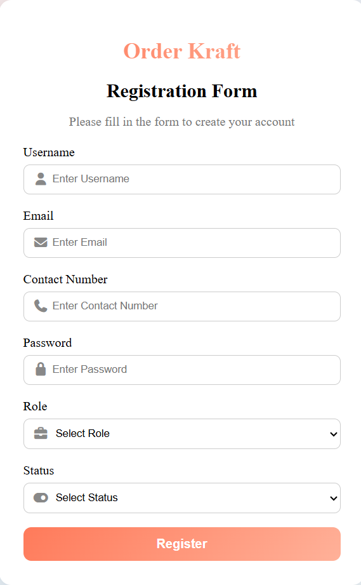
1.1Registration
Use Case 1: User Authentication and Role Management
Purpose:
To ensure secure user onboarding, manage login credentials, assign roles, and control access to different system functionalities.
Admin registers new users, such as Admin, Inventory Managers, Procurement Officers, Suppliers, Production Managers.
Roles are defined and assigned during the registration process to determine user permissions.
A verification email is automatically sent to confirm the user's identity and activate their account.

Slide 7
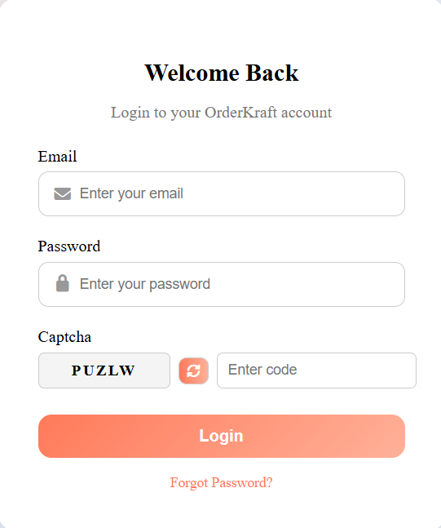
1.2 Secure Login
Users access the system by logging in with their username and password.
Once authenticated, a session is created and managed by the backend to maintain secure and continuous access.

Slide 8
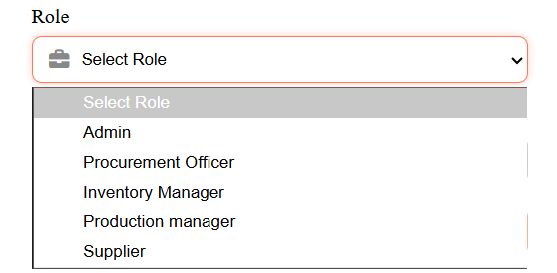
1.3 Role Assignment
The Admin assigns roles to users and can update them as needed.
System permissions are automatically applied based on the assigned role, ensuring secure and appropriate access.
Action Flow:
Admin selects a role.
The system automatically applies the correct permissions for that role.
Changes are saved and reflected immediately in the user’s access level.

Slide 9
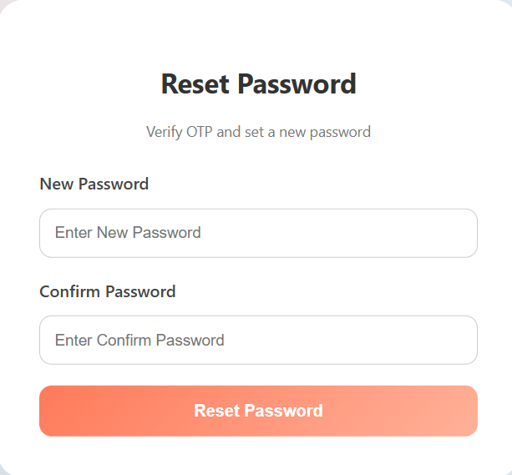
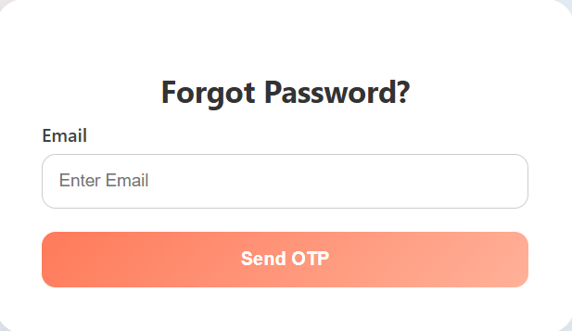
1.4 Password Reset
Users can select the "Forgot Password" option to reset their password.
A one-time password (OTP) is sent to the user’s registered email for verification.
After verifying the OTP, users can create a new password.
The new password must follow the system’s security policy.

Slide 10
1.5 Password Policy Enforcement
Minimum 8 characters, at least 1 uppercase & 1 number.
Real-time validation feedback during input.
Prevents reuse of old passwords.
Configurable rules for future updates.

Slide 11
1.6 Account Lockout
The account is locked after 5 incorrect login attempts.
The user receives an email alert when their account is locked.
The Admin can unlock the account manually, or it can unlock automatically after a set cooldown period.
1.7 Session Timeout
Users are automatically logged out after 15 minutes of no activity.
Session data is cleared to keep accounts secure.
A warning message appears before the logout happens.
This feature works for all user roles.

Slide 12
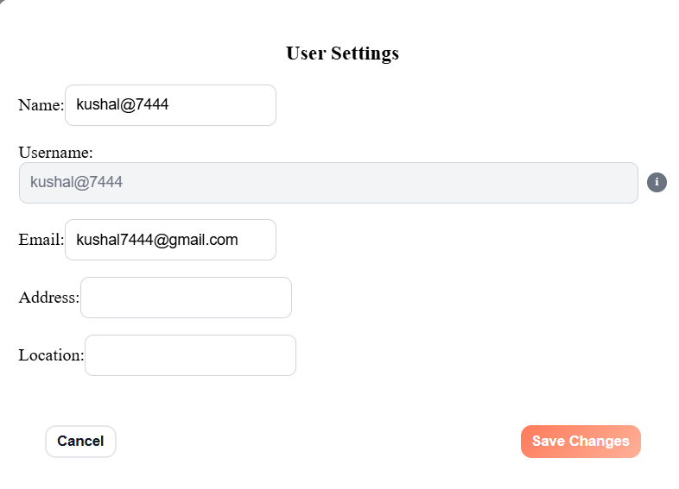
1.8 User Profile Update
Users can edit personal information like phone number and address.
All changes are checked for accuracy before saving.
Sensitive changes, like updating an email address, may need verification.
The system keeps a record of all profile updates.

Slide 13
Purpose: To help users, especially Procurement Officers, easily create, update, track, and cancel orders for smooth and efficient order processing.
Use Case 2: Order Creation and Management
Procurement Officer Dashboard

Slide 14
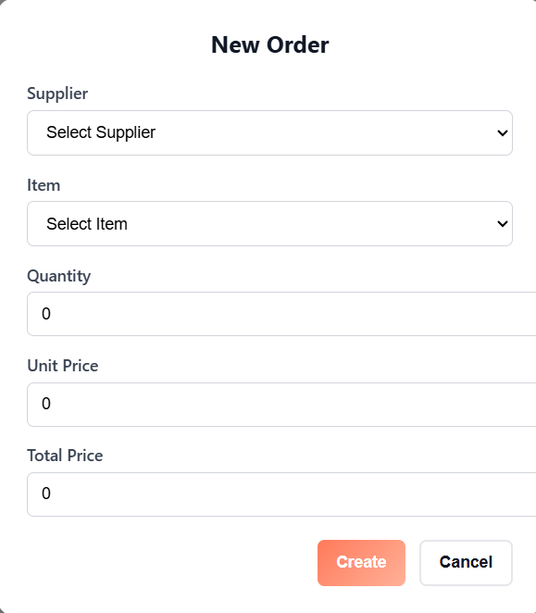
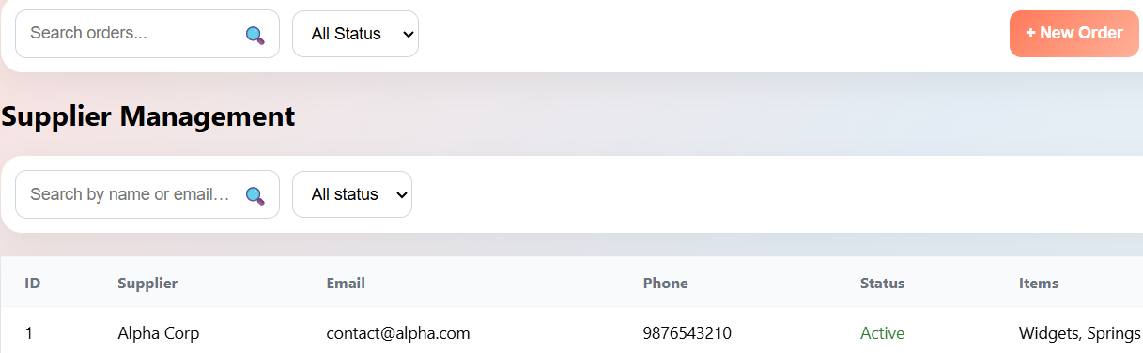
1.1 Create Order
Procurement Officer enters item and supplier information.
System validates the details and saves the order.

Slide 15
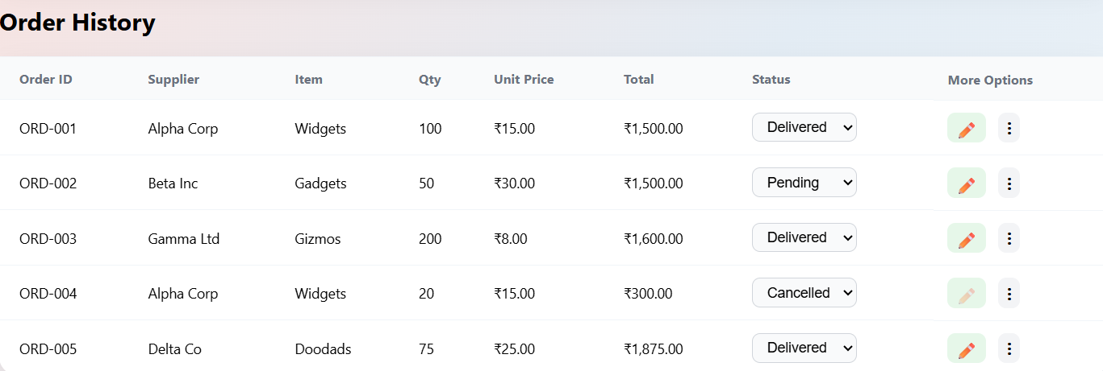
1.2 View Order History
Users can see previous orders and filter them by date, status, or supplier.
Helps users quickly find and track past orders.

Slide 16
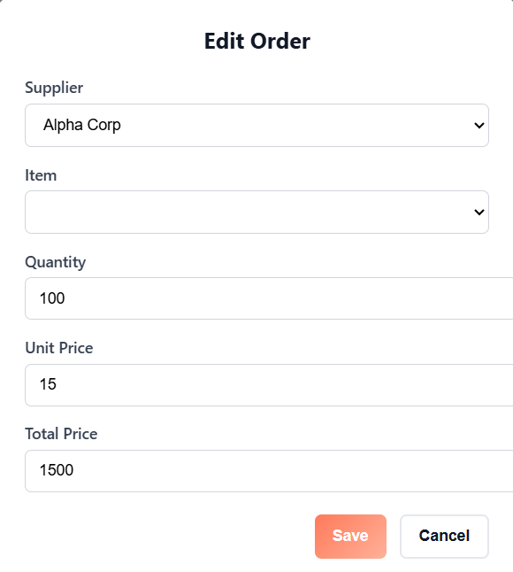
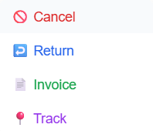
1.3 Update Order Details
Users can change the quantity, delivery date, or other order details.
The system checks the updates and saves them.

Slide 17
1.4 Track Order Status
Suppliers or systems send real-time order updates.
Users can check the current status and expected delivery time.

Slide 18
1.5 Cancel Order
Users can cancel orders that are no longer required.
The system changes the order status and sends notifications to stakeholders.

Slide 19
1.6 Order Payment Integration
The system connects to a payment gateway to handle payments.
Order status is updated based on whether the payment succeeds or fails.

Slide 20
1.7 Invoice Generation
Admin can generate invoices for completed and paid orders.
Invoices can be downloaded or printed as needed.

Slide 21
1.8 Return Order
Customers can request a return for defective items.
The system updates inventory and changes the order status.

Slide 22
THANK - YOU

